Slide 1
Goring and Woodcote Medical Practice
Patient Participation Group (PPG)
Open Meeting
Obesity and Self-Care
4 November 2017

Slide 2
Agenda
PPG Notices:
  OCCG Primary Care Meeting – George Hotel Wallingford, 28 Nov 1830-2000
  Online access to medical records –help with the “Patient Access” programme
Obesity – the Primary Care perspective – Dr Andy Goode
Obesity Treatments – Mr Greg Jones
Questions

Slide 3
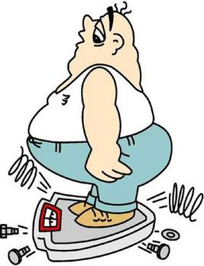
Goring & Woodcote Medical Practice PPG Open Meeting
OBESITY
Presented by
Dr Andy Goode
4 November 2017
Notes:
This presentation demonstrates the new capabilities of PowerPoint and it is best viewed in Slide Show. These slides are designed to give you great ideas for the presentations you’ll create in PowerPoint 2011!
For more sample templates, click the File menu, and then click New From Template. Under Templates, click Presentations.

Slide 4
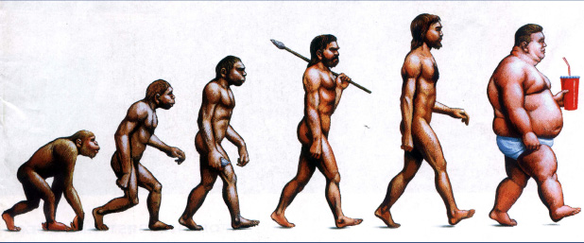

Slide 5
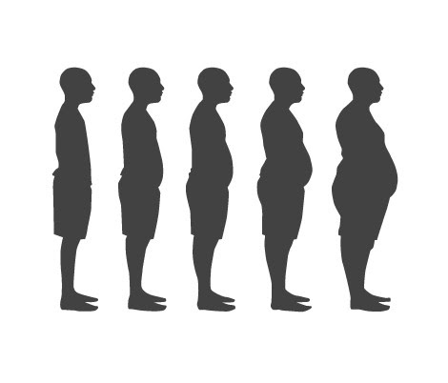
OBESITY
What we are going to cover…
The facts and figures relating to obesity
The health problems obesity can cause
How the Practice team can help patients who want to tackle their obesity problem
What secondary care can offer – eg bariatric surgery

Slide 6
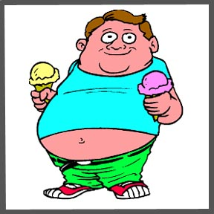
Obesity – the facts
Obesity represents the greatest threat to health in the developed world, with poor diet contributing to more disease than physical inactivity, smoking and alcohol combined.
Obesity rates have almost doubled in the last 20 years!
It is suggested that by 2050 obesity will have an annual cost to the nation of nearly £50 billion pounds.
The majority of the obese adult population do not identify themselves as either obese or even very overweight.

Slide 7
What is Obesity ?
Overweight and obesity are terms that refer to an excess of body fat and they usually relate to increased weight-for-height. The most common method of measuring obesity is the
Body Mass Index (BMI).
In adults, a BMI of 25kg/m² to 29.9kg/m² means that person is considered to be overweight, a BMI of 30kg/m² or higher means that person is considered to be obese.
This is a crude tool.

Slide 8

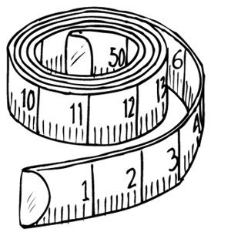
(NICE) recommends the use of BMI in conjunction with waist circumference as the method of measuring overweight and obesity and determining health risks.
In order to measure abdominal obesity, waist circumference is measured, and categorised into desirable, high and very high,
by sex-specific thresholds.
Men
Desirable = Less than 94 cms (<37”)
High = Between 94-102 cms (37”-40”)
Very high = More than 102 cms (>40”)
Women
Desirable = Less than 80 cms (<31”)
High = Between 80-88 cms (31”-34”)
Very high = More than 88 cms (>34”)

Slide 9
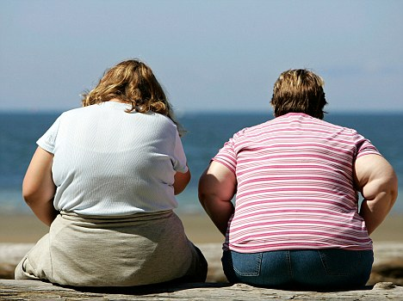
Adult obesity: Prevalence
Obesity prevalence varies with age for both males and females, with the highest obesity levels in the 55-64 age group.

Slide 10
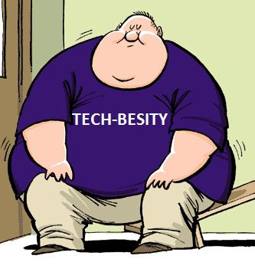
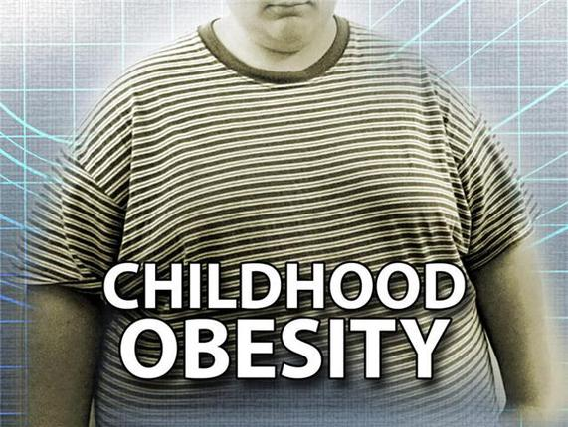
OBESITY STATISTICS
In 2015, 58% of women and 68% of men were overweight or obese.
Obesity prevalence increased from 15% in 1993 to 27% in 2015.
In 2015/16, over 1 in 5 children in Reception, and over
1 in 3 children in Year 6 were measured as
obese or overweight.

Slide 11
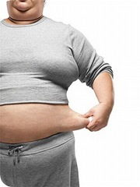
Prevalence of
morbid obesity (a BMI of 40+) has more than tripled since 1993, and reached 2% of men and 4% of women in 2015.

Slide 12

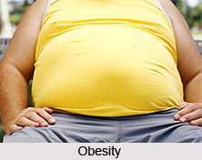
In 2015/16 there were 525,000 admissions in NHS hospitals where obesity was recorded as a contributory factor.

Slide 13
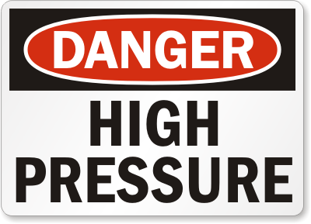
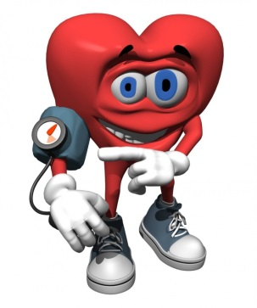
Health problems related to obesity
Hypertension
High blood pressure is twice as common among obese adults as among those of a
normal weight
(43% of obese men and 37% of obese women, compared with 21% of men and 18% of women with BMI within the normal range).

Slide 14
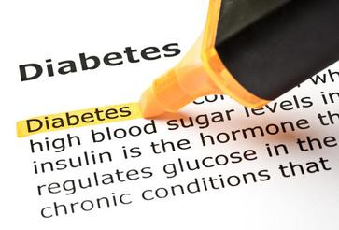
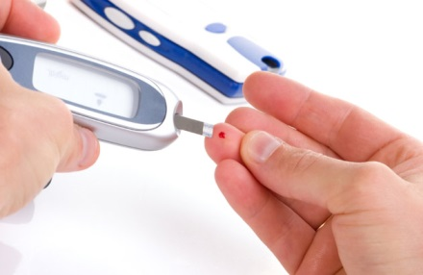
Health problems related to obesity
Diabetes
Number of people diagnosed with diabetes has increased by 60% in the last decade.
Prevalence of diabetes
(diagnosed and undiagnosed)
among adults with desirable
and very high waist circumference was
2% and 11% respectively.

Slide 15

Pre-diabetes
Higher risk of going on to develop diabetes than the background population.
A warning alarm.
Opportunity to reduce risk and change before diabetes develops.
Medication can help with this but weight loss through lifestyle change really helps.

Slide 16
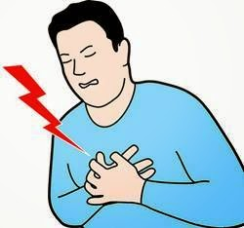
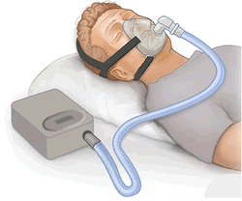
Obesity – other health risks
Heart disease & stroke
Some cancers
Depression & stress
Arthritis
Breathing problems, such as asthma and sleep apnoea (when a person stops breathing for short episodes during sleep)

Slide 17
Weight loss – not a simple solution?
It is widely recognised that obesity and tackling weight loss can also be heavily linked to psychological problems affecting a patient.
Depression
Obesity
At the Practice, we can help and support patients and refer them for specialist opinion as appropriate.

Slide 18
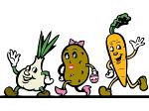
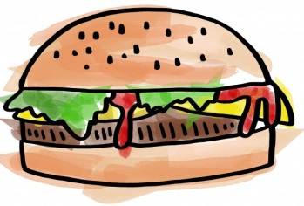

How can patients help themselves - diet?
26% of adults ate the recommended 5 or more portions of fruit and vegetables a day in 2015. Women (27%) were more likely to do so than men (24%).
Poor diet and nutrition are recognised as major contributory risk factors for ill health and premature death.

Slide 19
How can patients help themselves – diet
Start a diet – which one ? – how big is a normal portion ?
5:2 diet, Paelo diet, Cambridge diet, South Beach diet
See our portion size plates at the Practice
Join a slimming group - which one ?
Weightwatchers, Slimming World
OR
Come to the Practice and see Nicky our HCA who has a special interest in supporting patients through weight loss

Slide 20
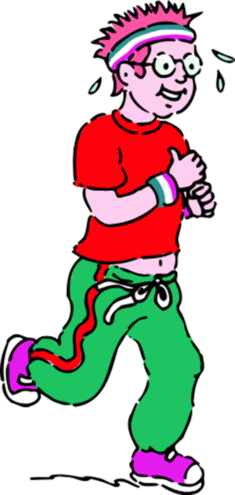
How can patients help themselves – activity ?
In 2015/16, 26% of adults were classified
as inactive
(fewer than 30 minutes physical activity a week).
Less active and less fit people have a greater risk of developing high blood pressure. Physical activity can reduce your risk for type 2 diabetes. Studies show that physically active people are less likely to develop coronary heart disease than those who are inactive.

Slide 21
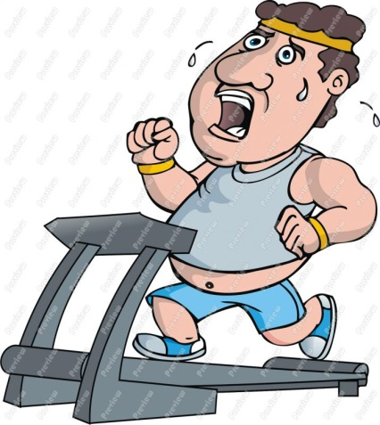
How can patients help themselves – activity
Join a local Gym or exercise at home!
Go for a walk!
Walking is simple, free, and one of the easiest ways to get more active, lose weight and become healthier. You don't have to walk for hours. A brisk 10-minute daily walk has lots of health benefits and counts towards your recommended 150 minutes of weekly exercise
Join the local Goring Gap Health Walks!
Go for a swim!
Join a dance class!
Anything to get you moving and hopefully having fun!

Slide 22
How can we help patients in primary care
Help and support patients who want to lose weight and become more active
Monitor their progress
Refer patients to weight loss and activity programmes

Slide 23
Medication
Orilstat
  Can only be continued if causing weight loss
  Affects absorption of fat from the gut
  Causes diarrhoea
GLP-1 agonist
  Medication (injection) that we can use in diabetic patients to improve blood glucose control and fortuitously causes some weight loss in certain patients.

Slide 24
Options in secondary care
We can refer patients to secondary care so that they can discuss options such as weight loss surgery, also called bariatric or metabolic surgery, which is sometimes used as a treatment for people who are very obese.
It can lead to significant weight loss and help improve many obesity-related conditions, such as type 2 diabetes or high blood pressure.
But it's a major operation and in most cases should only be considered after trying to lose weight through a healthy diet and exercise.

Slide 25


What are the Treatments for Obesity
Mr Greg Jones
Consultant Upper GI & Bariatric Surgeon
Royal Berkshire NHS Foundation Trust

Slide 26
What I will cover
Secondary care treatment options
  Non-surgical weight loss
  Bariatric surgery
Secondary treatment options for diabetics
What surgery involves
Outcomes from surgery

Slide 27
Model of Care in the UK
Tier 4 - Specialised Complex Obesity Services (including bariatric surgery)
Tier 3 - Multi-disciplinary team obesity service to provide an intensive level of input to patients.
Tier 2 - Primary Care with Community Interventions
Tier 1 - Primary Care and Community Advice

Slide 28
BMI
Height | Overweight BMI 25-30 | Obese I BMI 30-35 | Obesity II BMI 35-40 | Obesity III BMI 40+
5’3 | 10 st. 1 | 12 st. 2 | 14 st. 2 | 16 st. 2
5’6 | 11 st. 1 | 13 st. 4 | 15 st. 8 | 17 st. 11
5’9 | 12st. 0 | 14 st. 6 | 16 st. 12 | 19 st. 4
6’0 | 13st. 2 | 15 st. 11 | 18 st. 6 | 21 st. 1
6’3 | 14 st. 5 | 16 st. 1 | 20 st. 2 | 23 st. 0

Slide 29
BMI
Height | Overweight BMI 25-30 | Obese I BMI 30-35 | Obesity II BMI 35-40 | Obesity III BMI 40+
5’3 | 10 st. 1 | 12 st. 2 | 14 st. 2 | 16 st. 2
5’6 | 11 st. 1 | 13 st. 4 | 15 st. 8 | 17 st. 11
5’9 | 12st. 0 | 14 st. 6 | 16 st. 12 | 19 st. 4
6’0 | 13st. 2 | 15 st. 11 | 18 st. 6 | 21 st. 1
6’3 | 14 st. 5 | 16 st. 1 | 20 st. 2 | 23 st. 0

Slide 30
Tier 3 weight loss
Up to 77,000 people in West Berkshire.
Not currently available
Who gets priority?

Slide 31
BMI
Height | Overweight BMI 25-30 | Obese I BMI 30-35 | Obesity II BMI 35-40 | Obesity III BMI 40+
5’3 | 10 st. 1 | 12 st. 2 | 14 st. 2 | 16 st. 2
5’6 | 11 st. 1 | 13 st. 4 | 15 st. 8 | 17 st. 11
5’9 | 12st. 0 | 14 st. 6 | 16 st. 12 | 19 st. 4
6’0 | 13st. 2 | 15 st. 11 | 18 st. 6 | 21 st. 1
6’3 | 14 st. 5 | 16 st. 1 | 20 st. 2 | 23 st. 0

Slide 32
Tier 3 referral
  BMI > 50 (consider surgery as primary therapy)
  BMI > 40
  BMI > 35 + Obesity related co-morbidity
  BMI 30 – 34.9 with recent onset type 2 diabetes
  Lower BMI in recent onset diabetes in Asian population

Slide 33

Obesity related disease

Slide 34
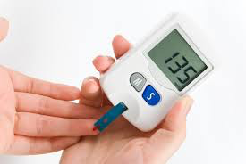
Obesity related disease

Slide 35
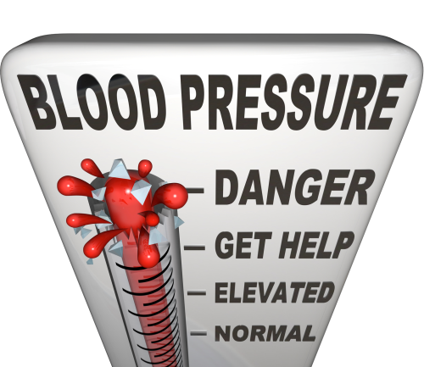
Obesity related disease

Slide 36
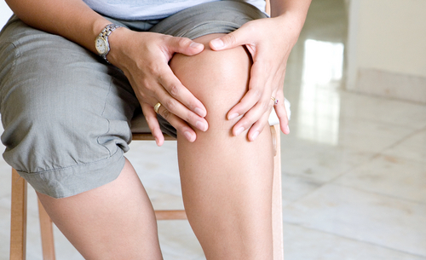
Obesity related disease

Slide 37
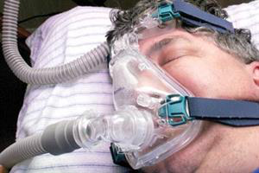
Obesity related disease

Slide 38
Obesity related disease
Diabetes
High blood pressure
Heart disease
Sleep apnoea
Arthritis
High cholesterol
Polycystic Ovaries
Asthma

Slide 39
Tier 3 weight loss
Dietician
Psychologist
Physician / GP
Trainer

Slide 40
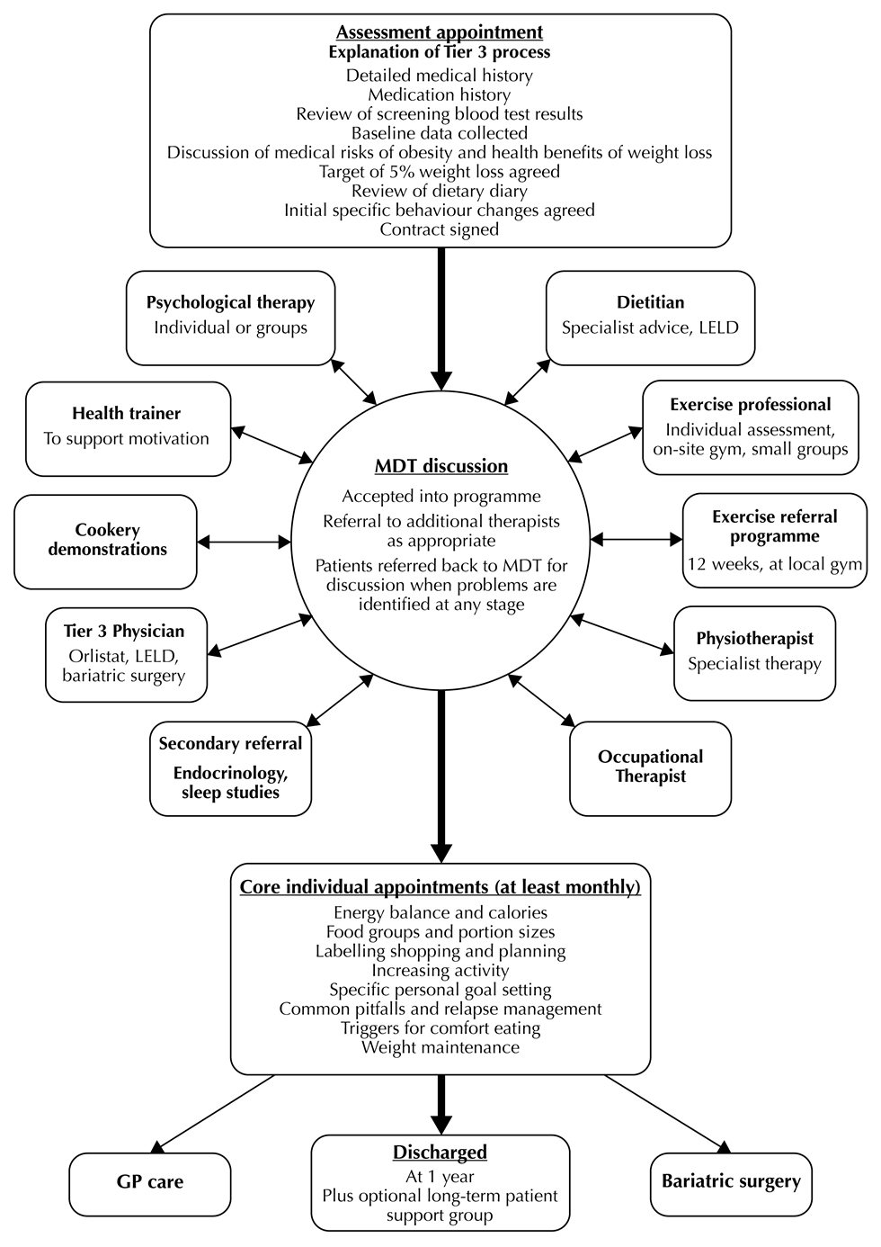

Slide 41
Tier 3 results
 | 12 months
Weight | 11kg = 1st 10lb
BMI | 43 → 41
Blood pressure | 130 → 120
Also:
Increase in exercise
Increase in quality of life
Improvement in diabetes
More likely to have their “5 a day”

Slide 42
Tier 3 results
BUT:
  Weight regain at 2-4 years
  Not available locally
  MOST health gains with 10% weight loss
  Results are around 8% weight loss

Slide 43
BMI
Height | Overweight BMI 25-30 | Obese I BMI 30-35 | Obesity II BMI 35-40 | Obesity III BMI 40+
5’3 | 10 st. 1 | 12 st. 2 | 14 st. 2 | 16 st. 2
5’6 | 11 st. 1 | 13 st. 4 | 15 st. 8 | 17 st. 11
5’9 | 12st. 0 | 14 st. 6 | 16 st. 12 | 19 st. 4
6’0 | 13st. 2 | 15 st. 11 | 18 st. 6 | 21 st. 1
6’3 | 14 st. 5 | 16 st. 1 | 20 st. 2 | 23 st. 0

Slide 44
Tier 3 for Type 2 diabetics
Structured programme
1. Active loss – 800KCal food eplacement
2. Re-introduction
3. Sustain
For BMI 28-35 Type 2 DM
Dr Theingi Aung - RBH

Slide 45
Tier 4 Royal Berkshire Hospital
  BMI > 50 (consider surgery as primary therapy)
  BMI > 40
  BMI > 35 + Obesity related co-morbidity
  BMI 30 – 34.9 with recent onset type 2 diabetes
  Lower BMI in recent onset diabetes in Asian population

Slide 46
Time line of assessment of RBH Obesity pathway for surgery
Baseline
Medical MDT (Endocrinologist, Specialist dietician, clinical psychologist) BSN-group sessions
6-months
3 months life style groups sessions (Specialist dietician, clinical psychologist)
Medical investigations & treatment of Co-morbidities; 1:1 section for intensive input-selective patient
12-18 months
Surgical MDT: Medical team, Surgeons & Anaesthetics
10-12 months
Review by medical MDT clinic (notes) review
medical review, weight target, patient engagement to programme, Low calorie diet pathway
Follow-up
Drop in clinics, Band adjustments, Group supports, Medical reviews

Slide 47
Royal Berkshire Hospital
Surgical Team:
  3 consultant surgeons
  supported by 8 junior doctors
Consultants:
  See each others patients
    Before and after surgery
    Operate on patients seen by other consultant
    May operate together

Slide 48
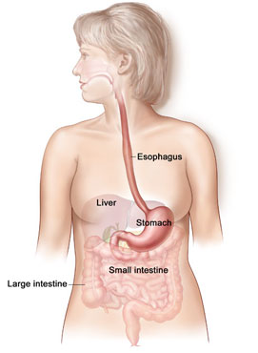
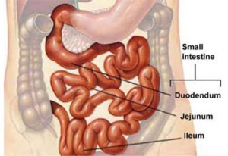
Stomach and intestinal tract

Slide 49
Operations
Intra-Gastric Balloon
Gastric Band
Sleeve Gastrectomy
Gastric Bypass

Slide 50
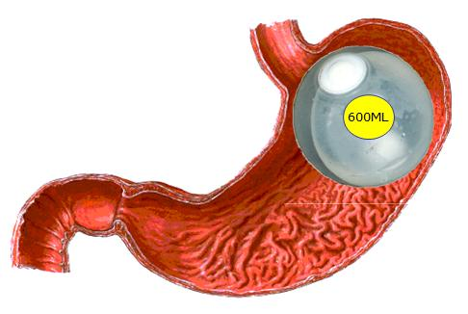
Gastric Balloon

Slide 51
Gastric Balloon
Day case procedure
Endoscopy - camera passed down gullet into stomach
General Anaesthetic
Balloon is size of 2 cans of Coke

Slide 52
Gastric Balloon
20-30% excess weight loss at 6 months
Need to be removed / replaced after 6 months
Feeling sick and vomiting common early on after the procedure.

Slide 53
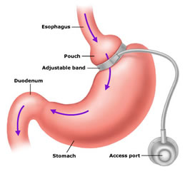
Gastric Band

Slide 54
Gastric Band
Arrive morning of Surgery
General Anaesthetic
5 small cuts (0.5-1cm)– KEYHOLE surgery
Takes 1 hour
Day surgery

Slide 55
Works by
Dividing the stomach with inflatable band
Adjustable to reach goal
Restricts amount you can eat
Stimulates nerves telling the brain you are full

Slide 56
Benefits
Safest, simplest procedure
Day case surgery
“reversible”
50-60% excess weight loss
No major nutritional problems
Good long term evidence that it works

Slide 57
Problems
Least amount of excess weight loss
Less effect on other medical problems
Less likely to cure/benefit diabetes
May take some time to achieve best fill of the band
Band slippage/erosion
Further surgery 30%

Slide 58
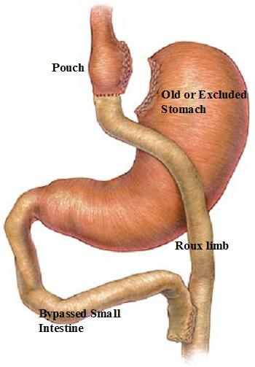
Gastric Bypass

Slide 59
Gastric bypass
Arrive morning of surgery
General Anaesthetic
5 small (1cm) cuts – KEYHOLE surgery
Takes 1.5 hours
2 nights stay, 60% have 1 night stay
2 week liquid diet

Slide 60
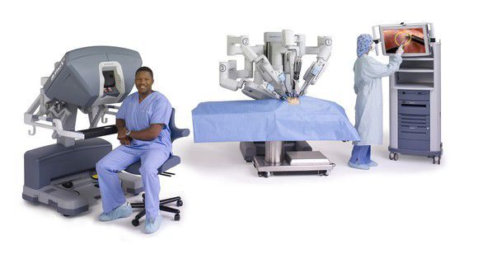
Robotic Gastric Bypass
Royal Berkshire – only place in the UK

Slide 61
Works by
Reducing the stomach to the size of your thumb.
  Reducing the amount you can eat
Separating most of the stomach from food
  Changes the hunger hormones so you feel less hungry
Re-arranging the small bowel
  Changes the hunger hormones so you feel full
These hormone changes help cure diabetes

Slide 62
Benefits
Most excess weight loss (70-80%)
Best for helping other medical problems
Highest cure for diabetes
Long term evidence (20 years)

Slide 63
Problems
More early complications than Band (although very few)
Longest operation
Re-arrangment of Anatomy
Small risk of leak
Nutritional supplements (tablet and injection) and blood tests required.

Slide 64
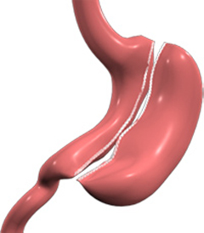
Sleeve Gastrectomy

Slide 65
Sleeve Gastrectomy

Slide 66
Sleeve Gastrectomy
Arrive morning of surgery
General Anaesthetic
5 small (1cm) cuts – KEYHOLE surgery
Takes 1 hour
2 nights stay
Water day of operation
Liquids day after surgery

Slide 67
Works by
Reduces amount you can eat as stomach is now one 5th of its original size
Removes the part of stomach from food that triggers hormone release
  Changes the hunger hormones so you feel less hungry
Food enters the small bowel quicker
  Changes the hunger hormones so you feel full
These hormone changes help cure diabetes

Slide 68
Benefits
Weight loss starts from time of surgery
Loose 50-70% of excess weight over 2 years
Cure or reduce need for diabetes medicines
No re-arrangement of anatomy
Less complicated than bypass

Slide 69
Problems
Not reversible
Risk of weight regain if “stretching of sleeve”
15% do not loose expected weight
Leak
Heart burn
Newer procedure, only have 10 year data

Slide 70
UK Outcomes

Slide 71
UK Diabetes

Slide 72
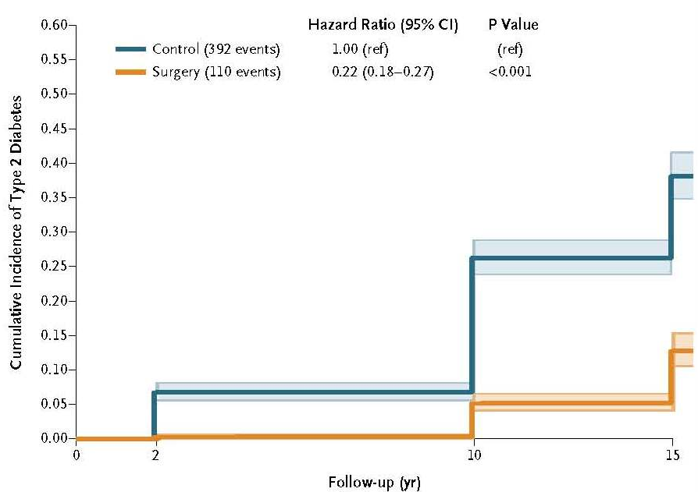
Diabetes Prevention

Slide 73
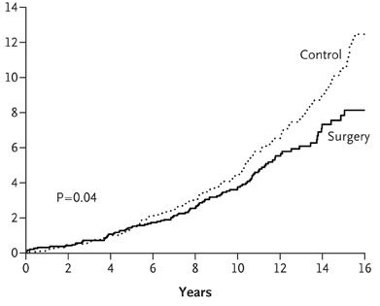
Risk of Dying

Slide 74
Day to day living
Improves activity and exercise
Most able to walk 3 flights of stairs
Back to work
Back to hobbies

Slide 75
Cancer
14% of deaths from cancer in men & 20% of deaths in women are due to overweight and obesity
Hospital visits for all cause cancer
  1 in 50 Bariatric surgery patients
  1 in 12 similar non-surgery patients
Breast cancer even more reduced.

Slide 76
Quality of life
Looked at for 25 years after bypass
Improvement seen from 5-25 years

Slide 77
Summary
Surgery
  Safe
  Best weight loss results
  Best results for other medical problems
  Keyhole surgery
Non-Surgical
  Limited
  Long term results not impressive

Slide 78
Referrals
NHS – Royal Berkshire Hospital
  Consult your GP for referral
Private – Spire Dunedin
  Same Surgeons and team
  0118 958 7676
  DunedinHospBariatrics@spirehealthcare.com

Slide 79
Questions?

